Slide 1


Slide 2
Now let me ask something..
Why do you want to learn Python/programming?
What would you use Python for?
Notes:
make notes

Slide 3
Failure
Coding is all about trial and error.
Don't be afraid of it.
Error messages aren't scary, they are useful.
Notes:
You might fail 5 times while doing something but in the end you will understand how it works and be able to replicate it

Slide 4
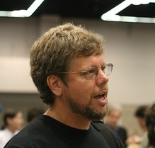
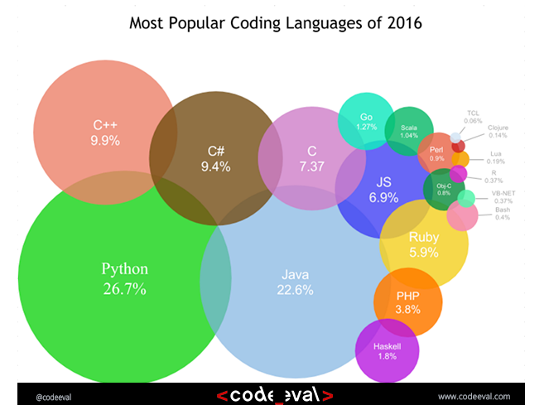
History
Started by Guido Van Rossum as a hobby
Now widely spread
Open Source! Free!
Versatile
Guido Van Rossum by Doc Searls on Flickr CC-BY-SA
Notes:
- Started by Guido Van Rossum as a hobby over the Christmas vacation.
- named after Monty Python's Flying Circus
- First released in 1991, loved by Unix scripters
- Now transformed into the most popular interpreted language. You can build anything with it!
- Facts! Python was the most used language in 2016 and still most likely is!

Slide 5
Python today
Developed a large and active scientific computing and data analysis community
Now one of the most important languages for
Data science
Machine learning
General software development
Packages: NumPy, pandas, matplotlib, SciPy, scikit-learn, statsmodels
Notes:
Why choose it instead of MATLAB, R, SAS, Stata and others?
- It is free and open source
- Intuitive and easy to learn
- Extremely versatile – examples – websites, planes, robots, data
- Large and friendly community
- packages
Very important in industry and academia

Slide 6


Slide 7
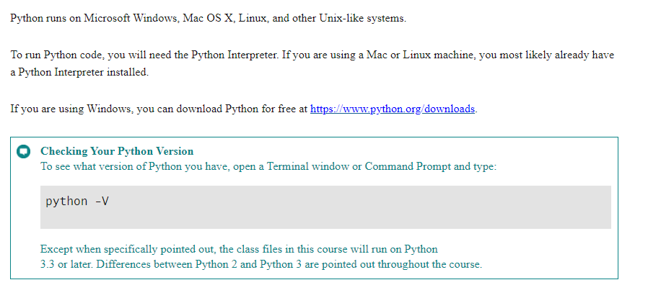
Running Python

Slide 8
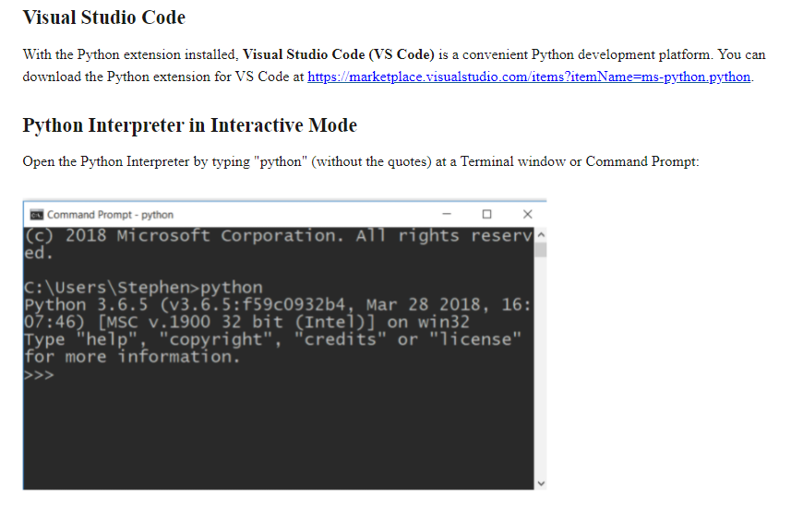
Editors and IDEs

Slide 9
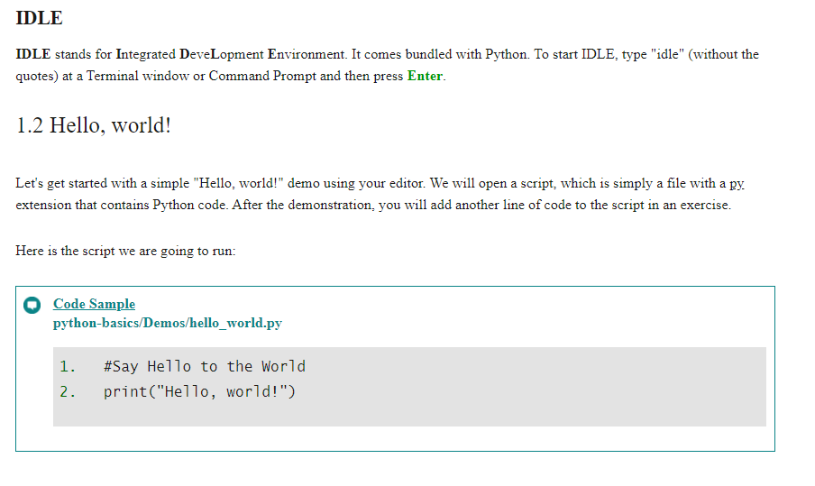
IDLE

Slide 10
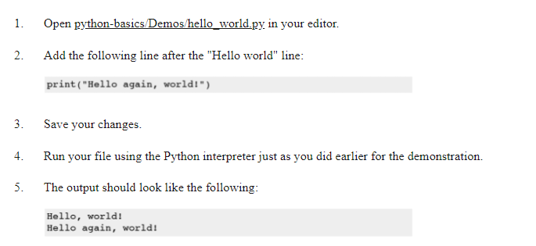
Exercise 1 Hello World

Slide 11
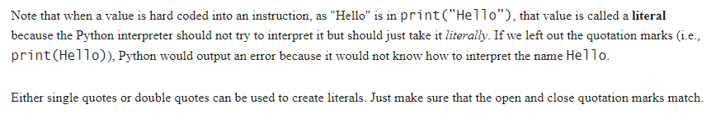
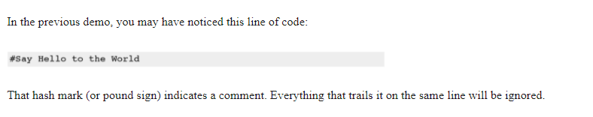
Literal and Comments

Slide 12
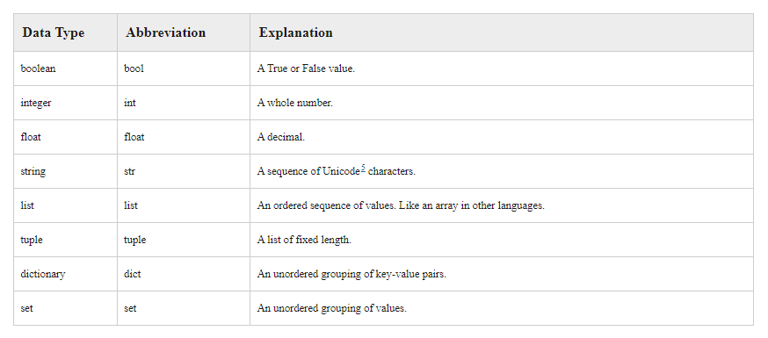
Datatypes

Slide 13
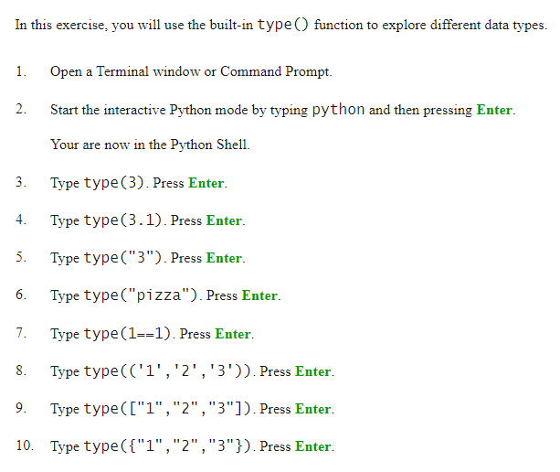
Exercise 2

Slide 14
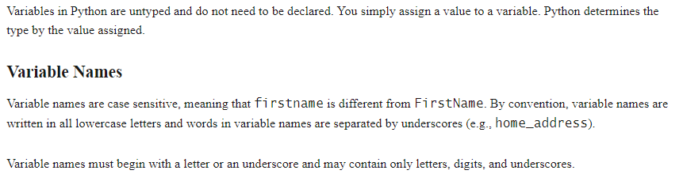
Variables

Slide 15
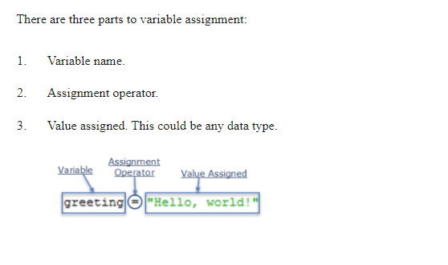
Variable Assignment

Slide 16
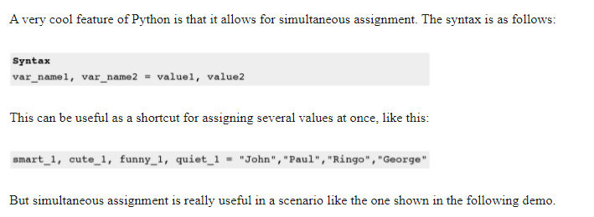
Simultaneous Assignment

Slide 17
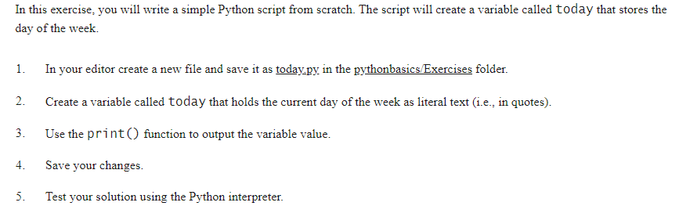
Exercise 3 A simple Python Script

Slide 18
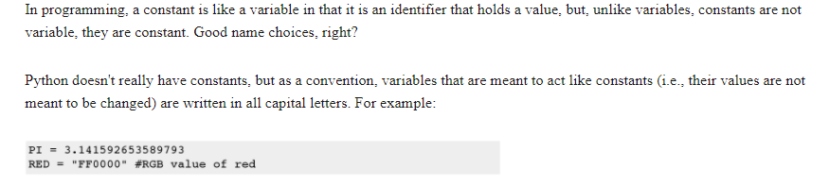
Constants

Slide 19
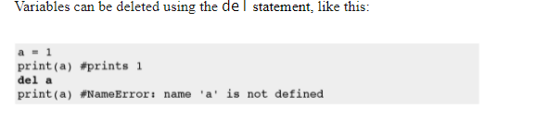
Deleting a variable

Slide 20
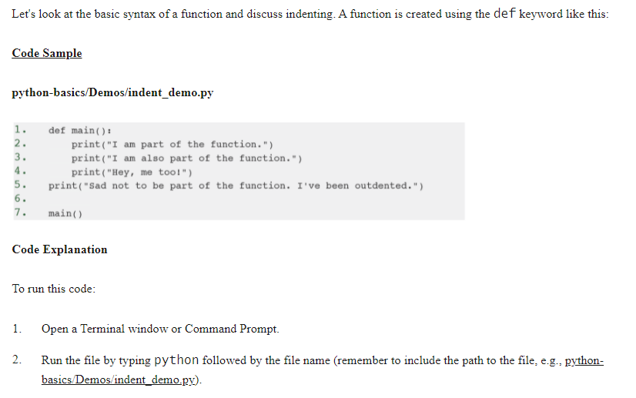
Writing a Python Module – main()

Slide 21
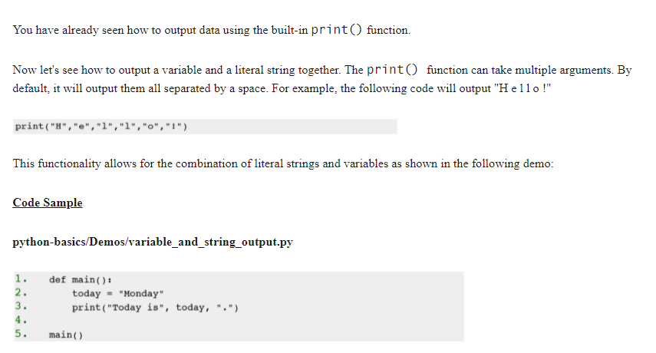
Print() function

Slide 22
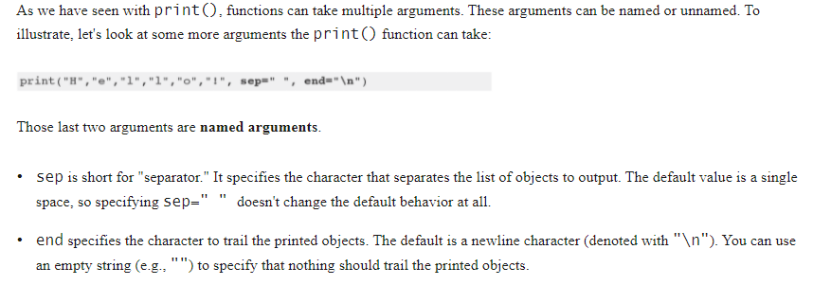
Named Arguments

Slide 23
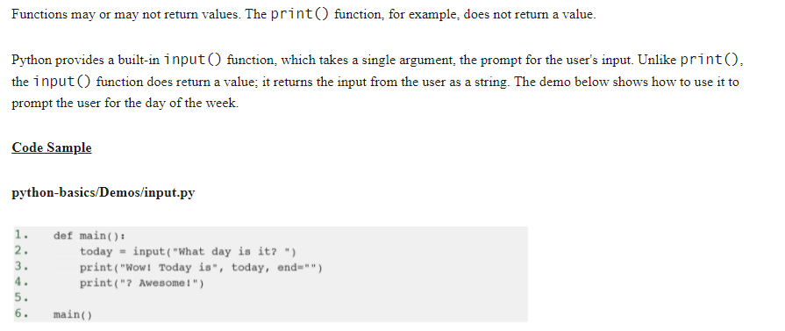
Collecting User Input

Slide 24
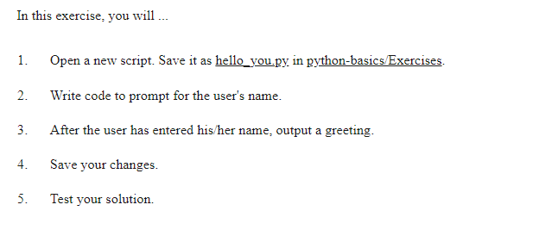
Exercise 4 Hello You

Slide 25
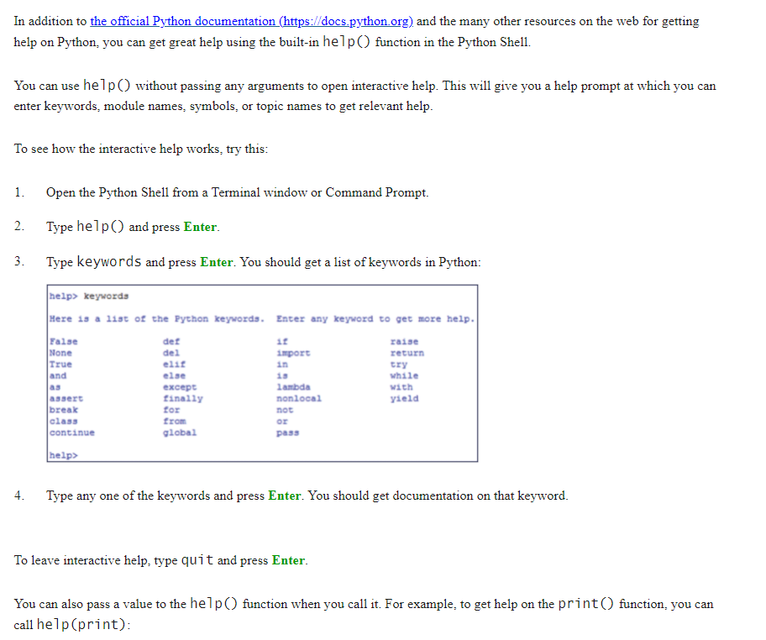
Getting Help

Slide 26
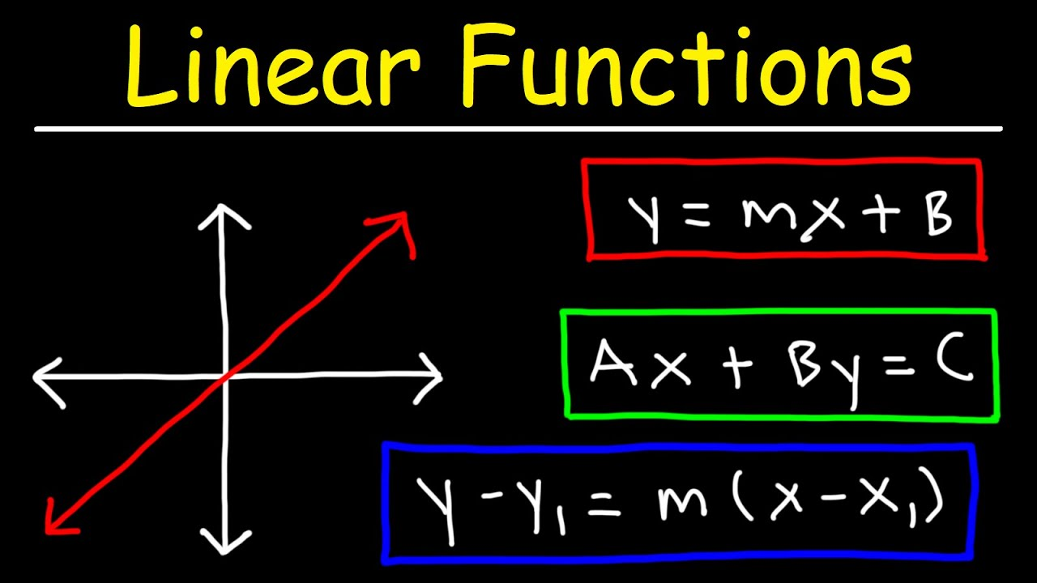

Slide 27
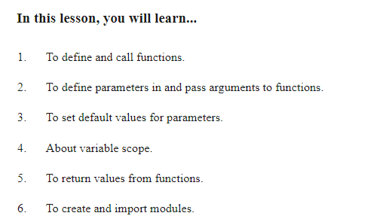
Functions and Modules

Slide 28
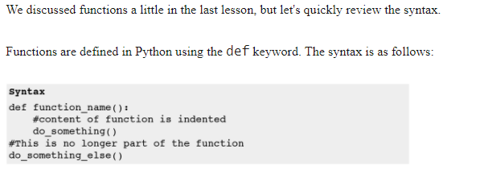
Defining Functions

Slide 29
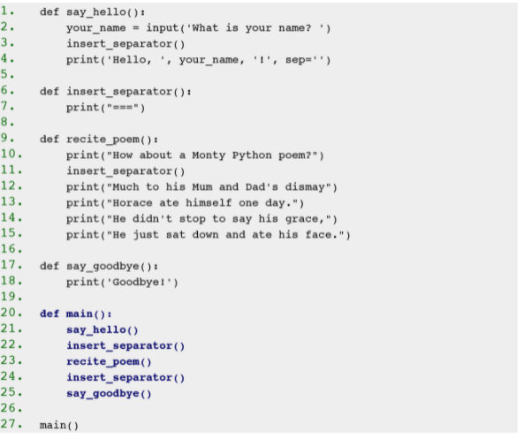
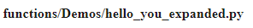
Example

Slide 30
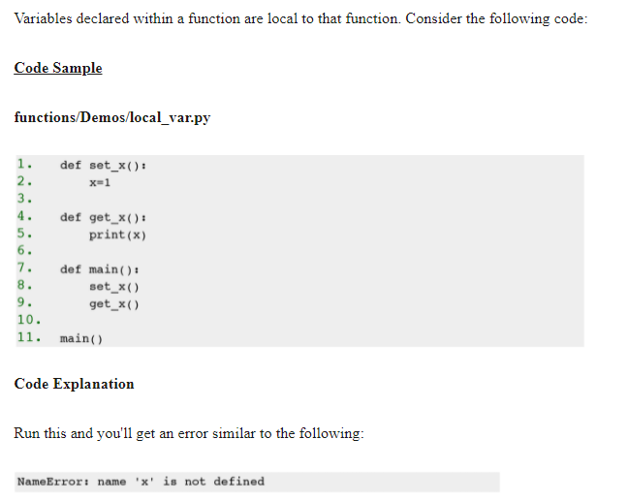
Variable Scope

Slide 31
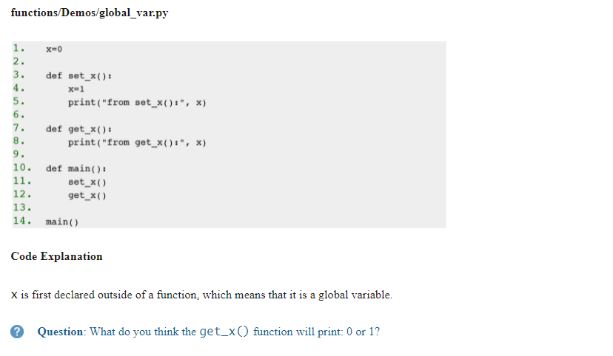
Global Variables

Slide 32
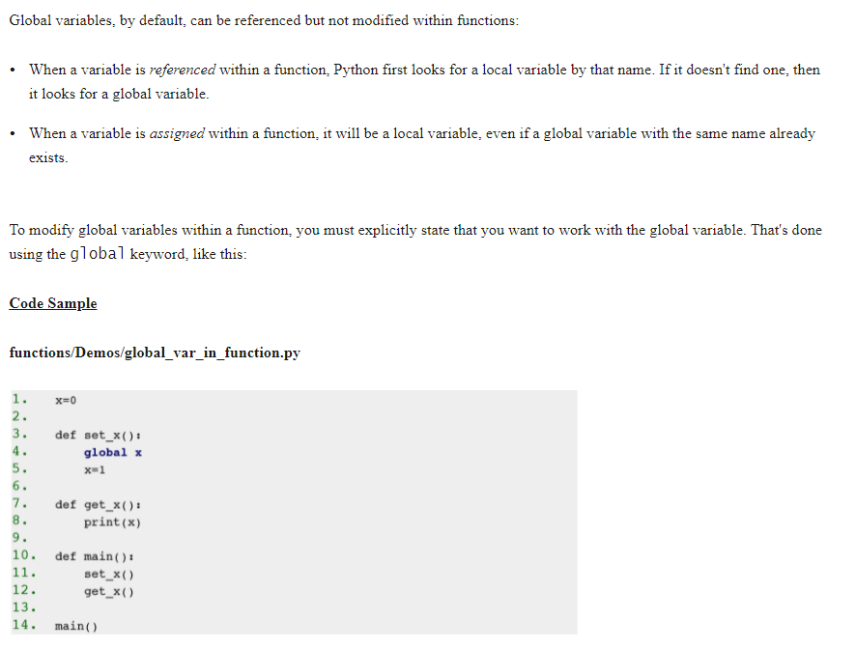

Slide 33
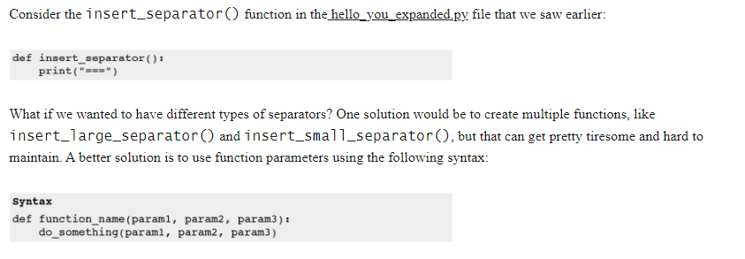
Function Parameters

Slide 34
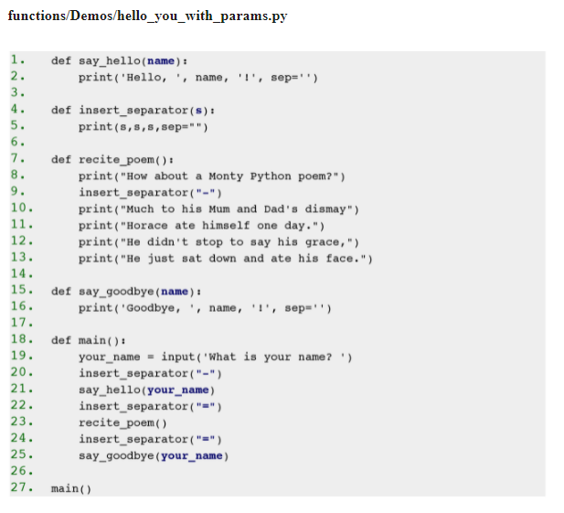
Parameter Example

Slide 35
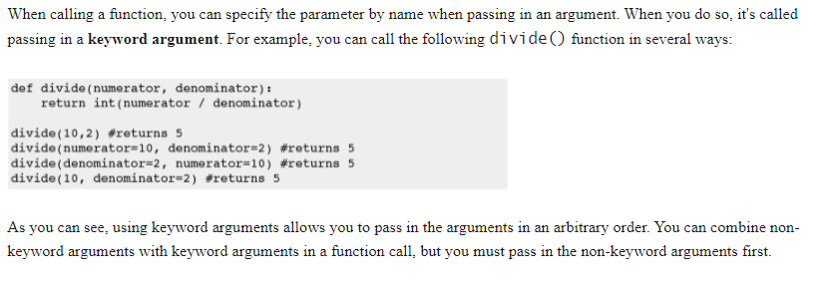
Parameter Names in calls

Slide 36
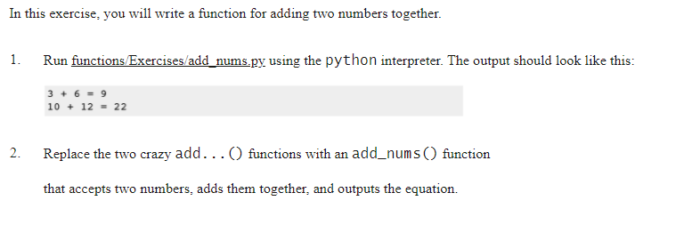
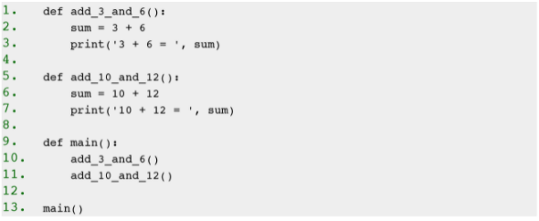
Exercise 5 A Function with Parameters

Slide 37
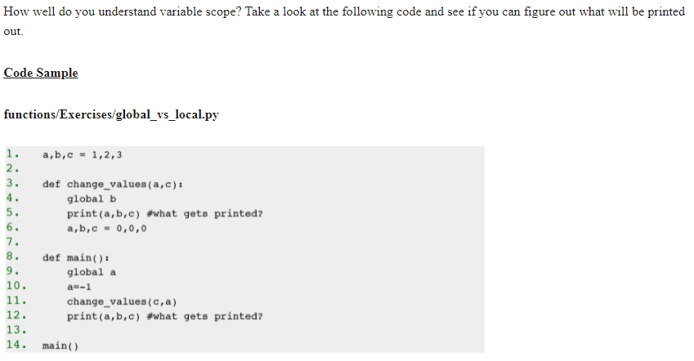
Exercise 5 Challenge
1,2,3
(3,-1)
Print 3,2,-1
1,0,3
-1,2,3

Slide 38
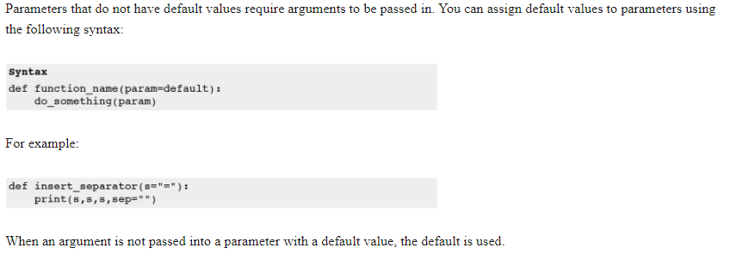
Default Values

Slide 39
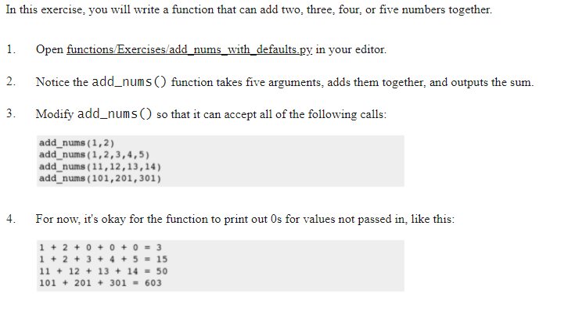
Exercise 6

Slide 40
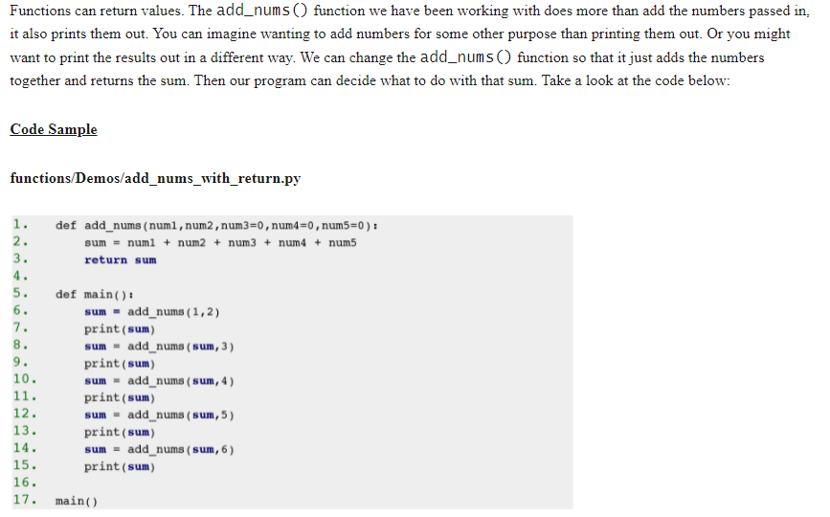
Returning Values

Slide 41
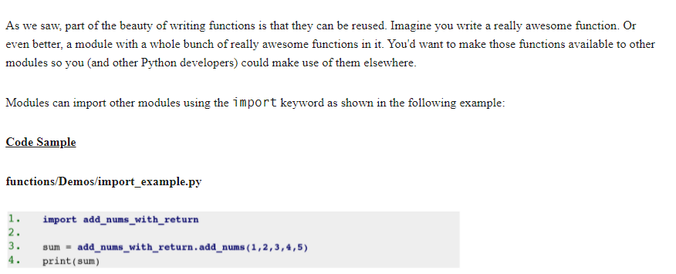
Importing Modules

Slide 42
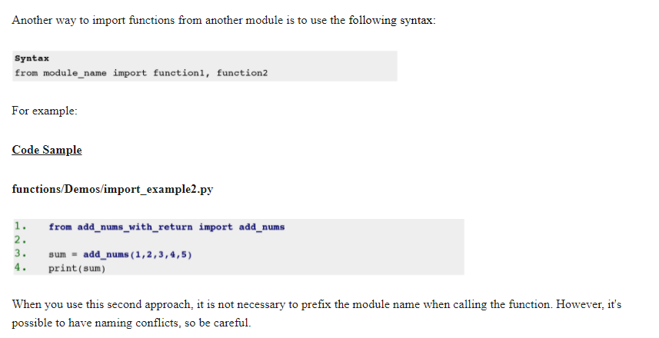
Importing Modules 2

Slide 43
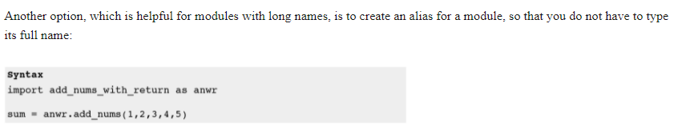
Module Alias

Slide 44
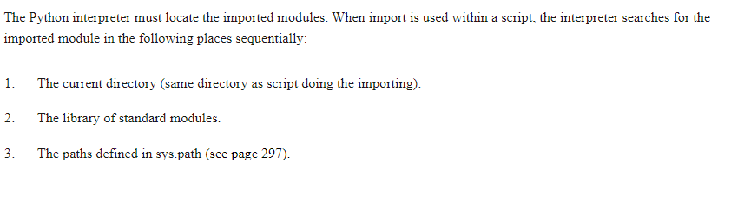
Module Search Path

Slide 45
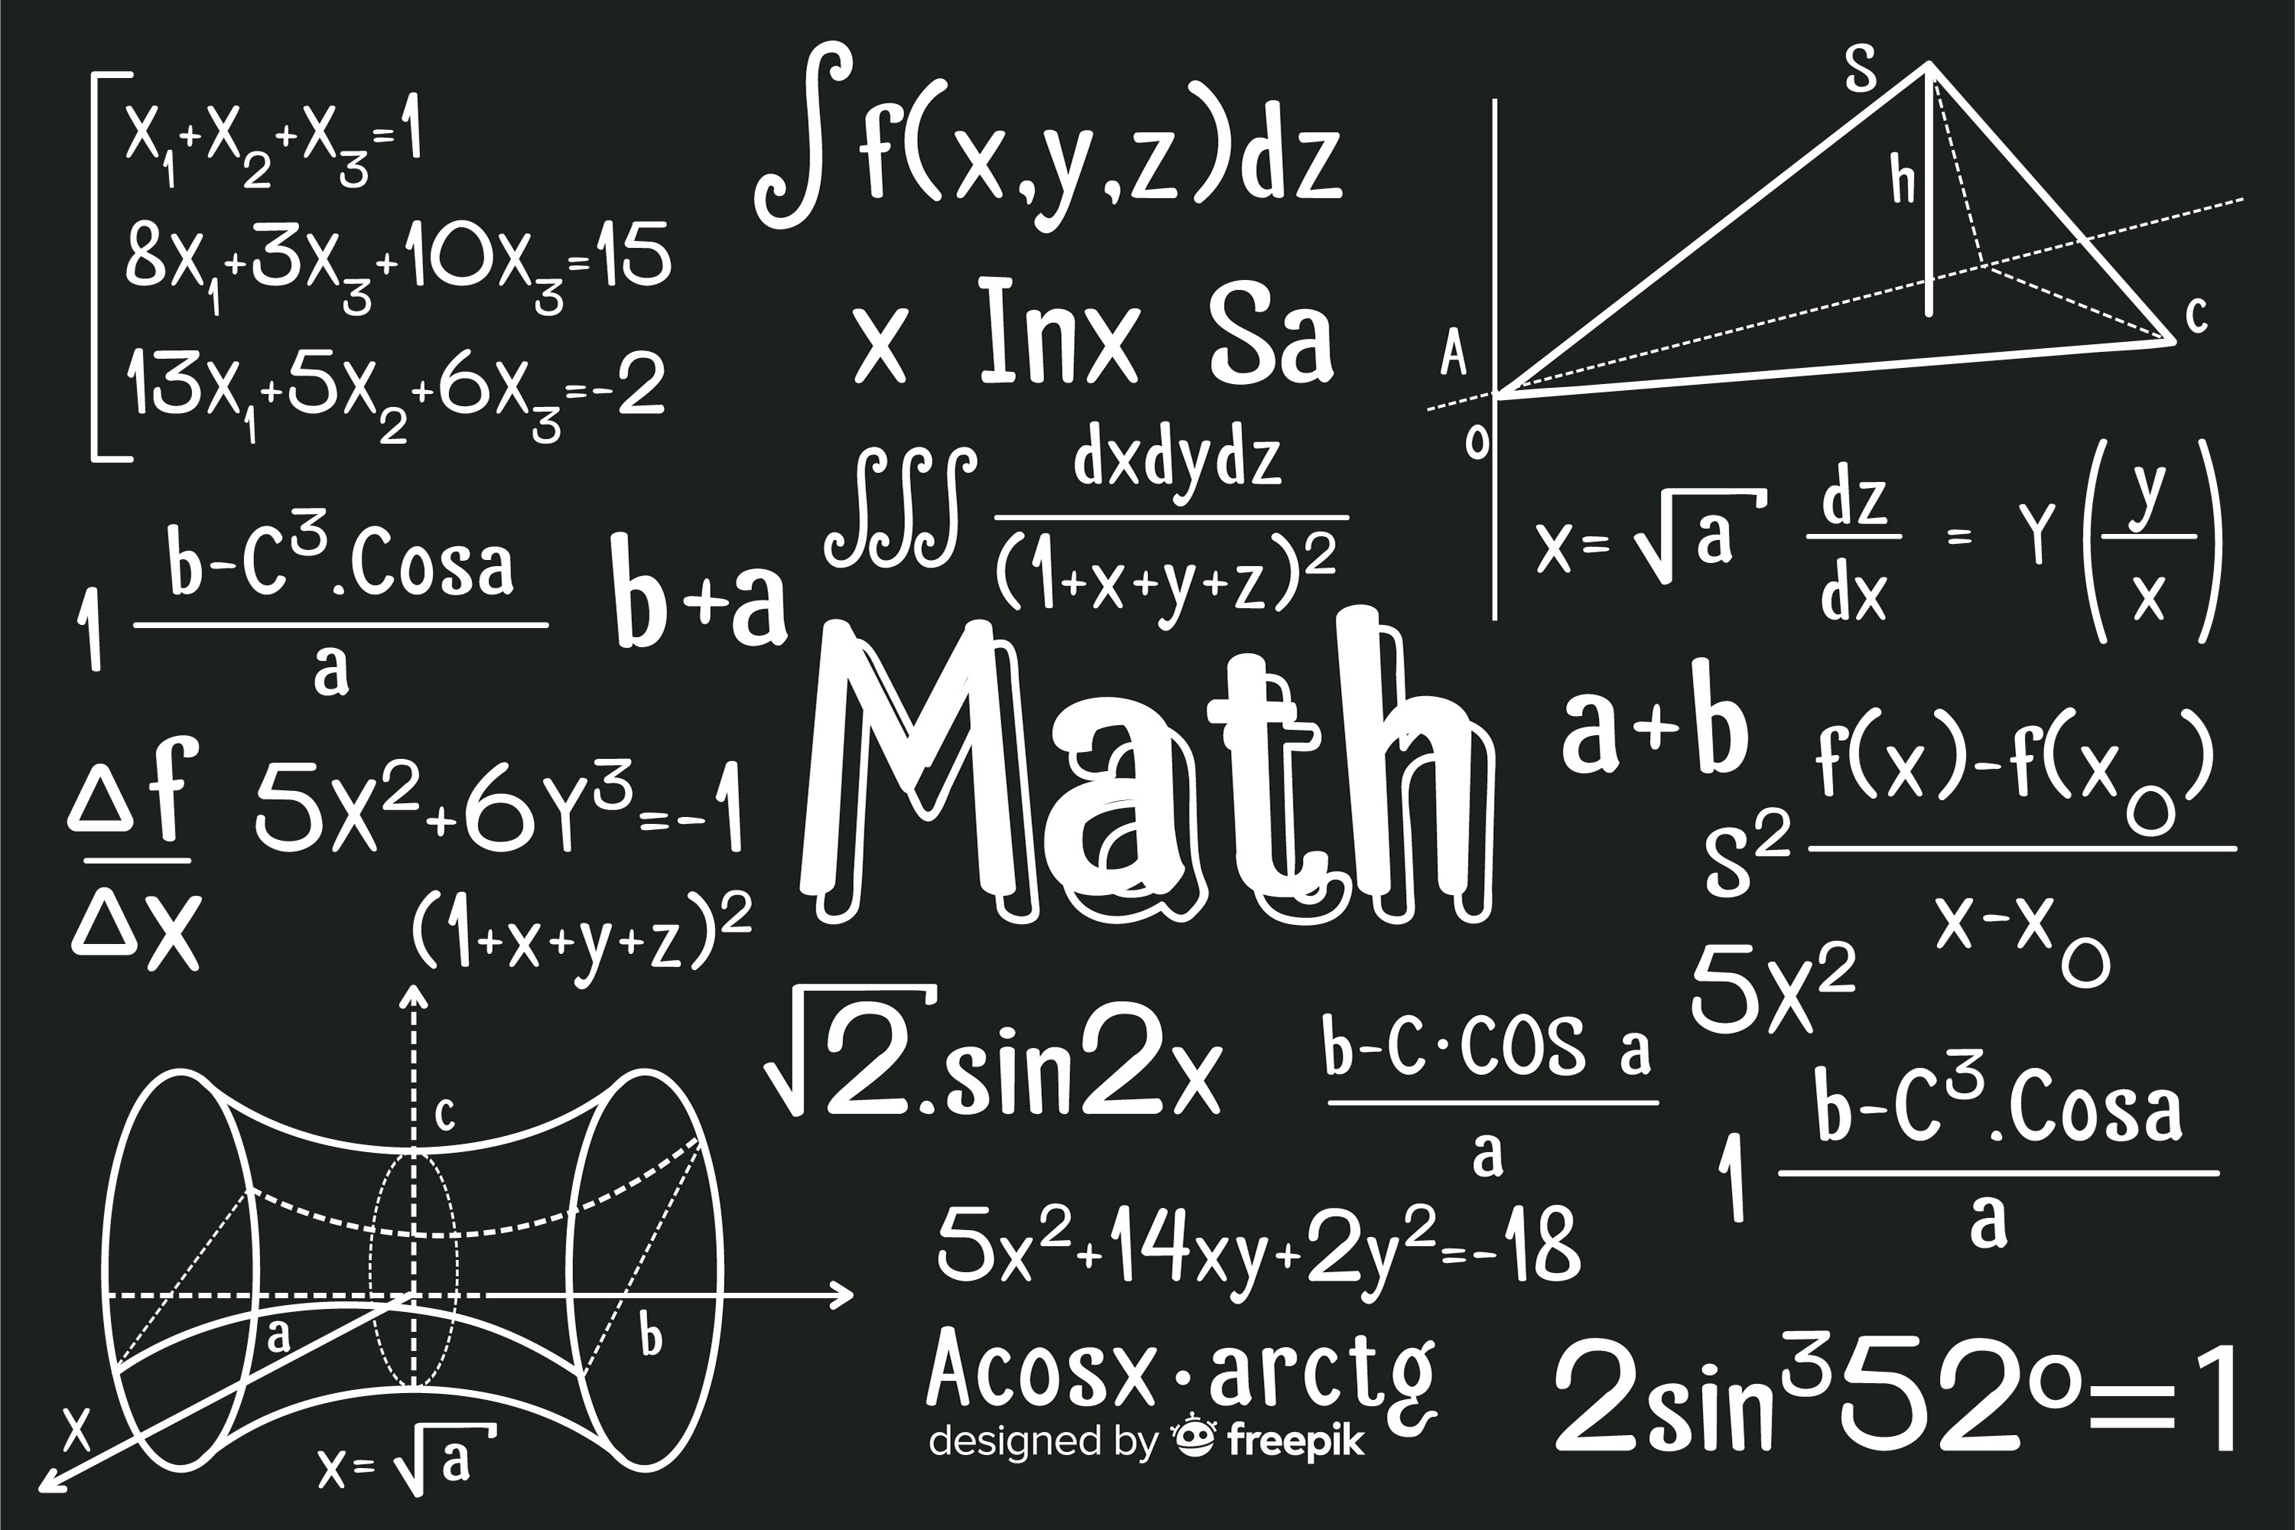

Slide 46
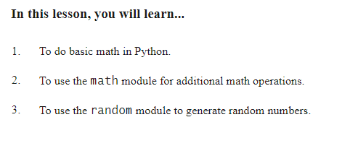
Math

Slide 47
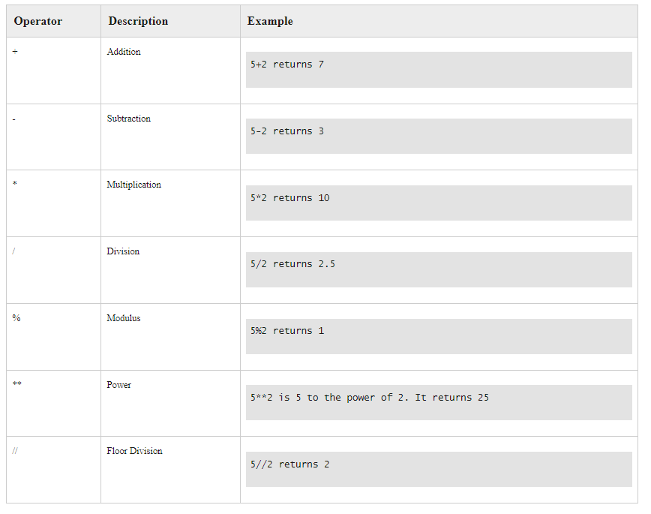
Arithmetic Operators

Slide 48
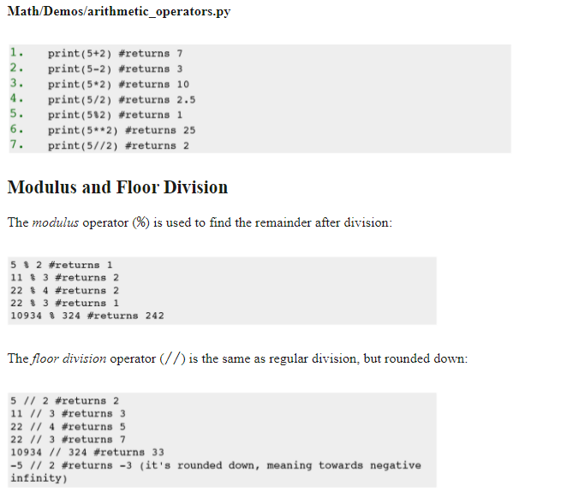
Example

Slide 49
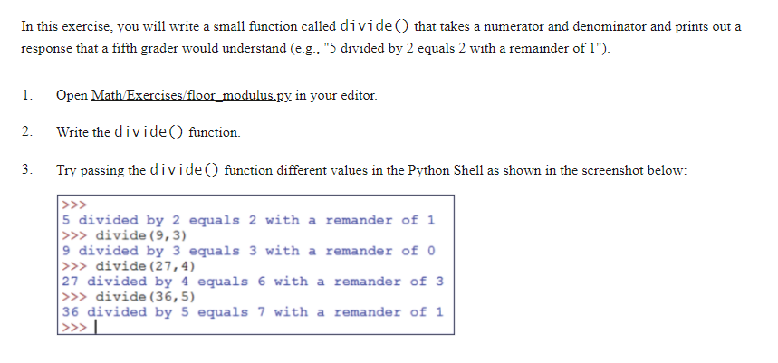
Exercise 7 Floor and Modulus

Slide 50
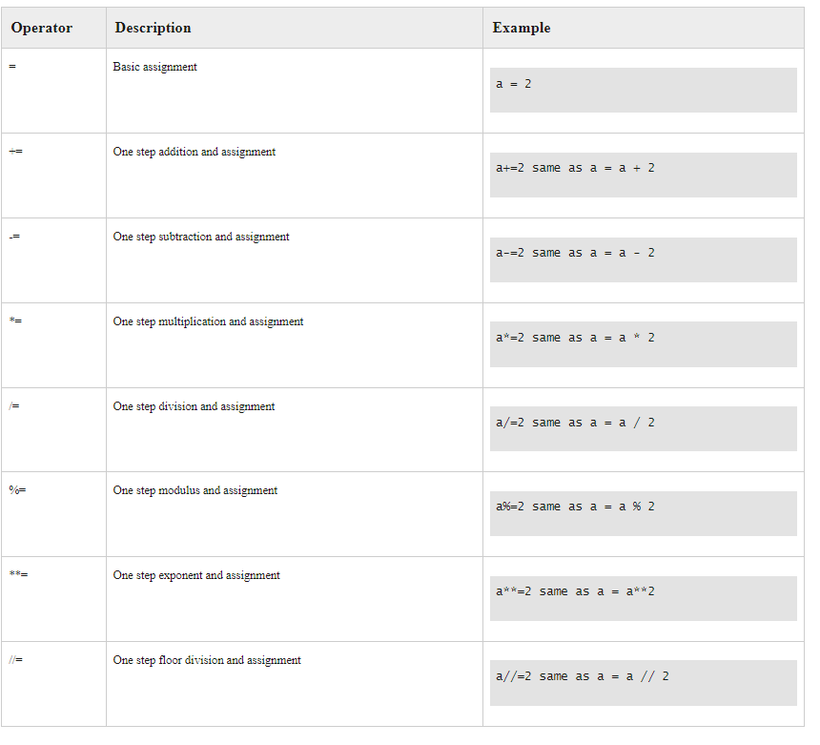
Assignment Operators

Slide 51
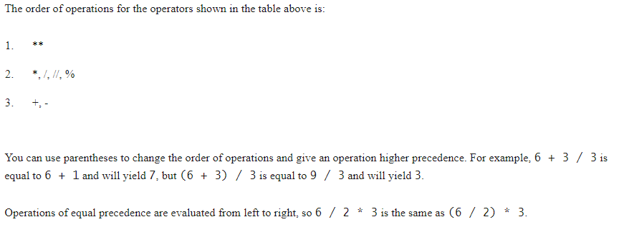
Operator Precedence

Slide 52

Build-in Math Functions

Slide 53


Slide 54


Slide 55



Slide 56


Slide 57

The Math Module

Slide 58



Slide 59

Additional Math Functions

Slide 60

Random Module

Slide 61


Slide 62

Seeding

Slide 63

Exercise 8 How Many Pizzas do we need?

Slide 64


Slide 65

Python Strings

Slide 66

Escaping Characters

Slide 67

Special Characters

Slide 68
Oefening
Hij zei: “Dit is een lastige tekst om te printen”
Piet zei: “Peter’s Tas ligt nog thuis”.
C:\test\new.txt
Print deze zinnen

Slide 69

Triple Quote

Slide 70


Slide 71

String Indexing

Slide 72


Slide 73

Exercise 9 Indexing Strings
Notes:
Hier zijn we gebleven!

Slide 74


Slide 75

Slicing Strings

Slide 76


Slide 77

Exercise 10 Slicing Strings

Slide 78


Slide 79

Concatenation

Slide 80

Repetition

Slide 81

Exercise 11 Repetition

Slide 82

Combining Concat and Repeat

Slide 83

String Methods

Slide 84



Slide 85


Slide 86
String Formatting

